Slide 1

HGF for Behavioural Analysis: Perceptual Model for Anxiety Patients During Lockdown
Branca Francesco, Menini Davide, Sangalli Sara
Notes:
Which is based on behavioral analysis on anxiety patients during lockdown using HGF

Slide 2








Motivation: Lockdown in Italy
Lack of healthcare goods
Project Idea
Tests
Tests
Today
Mar
Apr
May
Jun
2020
Lockdown
Phase 2
Notes:
We would like to briefly present the context that led us to the idea for this project.
-> We are 3 Italian students whose families have lived the lockdown in italy in first person. We wanted to combine our personal experience with the subject of the course.
->The first inspiration was brought by the lack of healthcare goods, such as masks or hand sanitizers, that affected italy since the very beginning of this period, which led to a general concern within the population.
->From this, we developed our project idea for anxiety analysis during lockdown.
-> Right afterwards, we started doing test to build our own dataset on italian subjects.

Slide 3











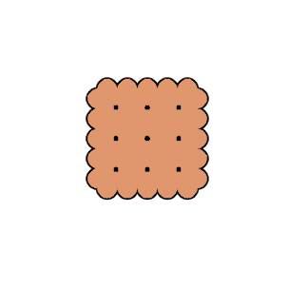
Goal: HGF for Anxiety Recognition
Anxiety Quiz
GOAL
(Ground Truth)
webapp
HGF
Psychologically Involving Test
webapp
HGF
= Healthy Controls
= Anxious Patients
Impartial Test
webapp
HGF
Notes:
Let me introduce you to the goal of our project.
We developed 3 test which we are going to describe more in details in a moment, namely 1 anxiety quiz, used to validate our results, 1 impartial test, 1 psychologically involving test.
->These three tests are delivered to the agents via a webapp developed by us, in order to make the experiment more accessible to a wider pool of subjects.
->Then we collect the results and we analyse and model them via HGF library and finally we use a clustering algorithm to separate anxiety patients from healthy controls.
Our goal is to compare the clustering obtained from the two tests with the ground truth provided by the anxiety quiz.
The hypothesis we want to validate is that the involving test provides results consistent with the ground truth, while the impartial test provides more random results, when compared to it.

Slide 4
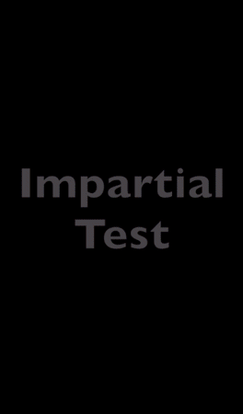
Experiment: Setup
Anxiety Quiz: 20 questions based on STAI. * 5 levels of anxiety detected, but only interested in a binary decision for results’ validation.
Involving Test: Sanitizers in shop A (y | n) Are there sanitizers in shop B?
Impartial Test: Biscuits in shop A (y | n) Are there biscuits in shop B?
* https://en.wikipedia.org/wiki/State-Trait_Anxiety_Inventory
Notes:
Let's describe the tests we proposed.
the animation shows the interface presented to our subjects.
Anxiety quiz: composed by 20 questions taken from STATE TRAIT ANXIETY INVENTORY.
the other two tests are structured in the same way.
the agent imagines to be in a daily situation at the supermarket, where they have to buy a certain good, which may or may not be present there.
After knowing this, they are asked to guess whether the same good is present or not in a nearby supermarket and they are shown the correct answer.
the information about the presence or absence of the good is provided as visual cues, as you can see in the demo.
The fundamental difference between the two tests relies on the involved good: biscuits for the impartial context, hand sanitizer for the psychologically involving one.

Slide 5
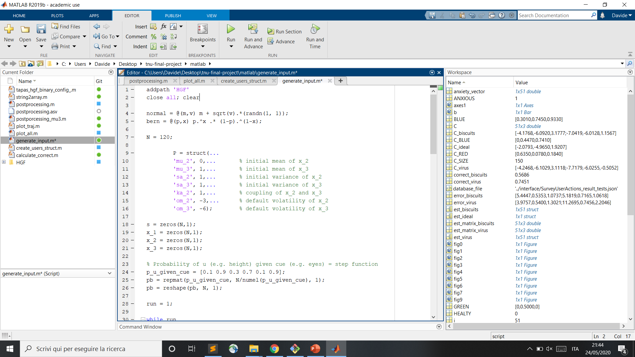
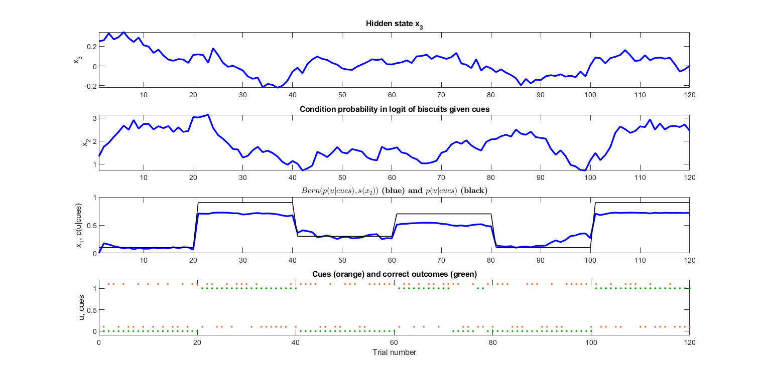
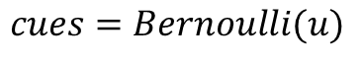
Experiment: Inputs
Correct Outcomes:
Cues:
$$u=GenerativeModel(P, p(u|cues))$$
$$cues=Bernoulli(u)$$
Notes:
This is how we generated the binary sequences for the experiment.
The correct outcomes are produced by a generative model which takes as input some parameters and the probability of outcomes themselves, given the cues. in particular this probability is shown here with the black line and it's a step function. (used to control the bernoulli distribution in the generative model).
The output of the generative model is shown with the blue line, which then we binarize and discretize and it is shown at the bottom with the green dots.
The cues are produced backwards via a bernoulli distribution of the correct outcomes and they are shown with the orange dots.

Slide 6
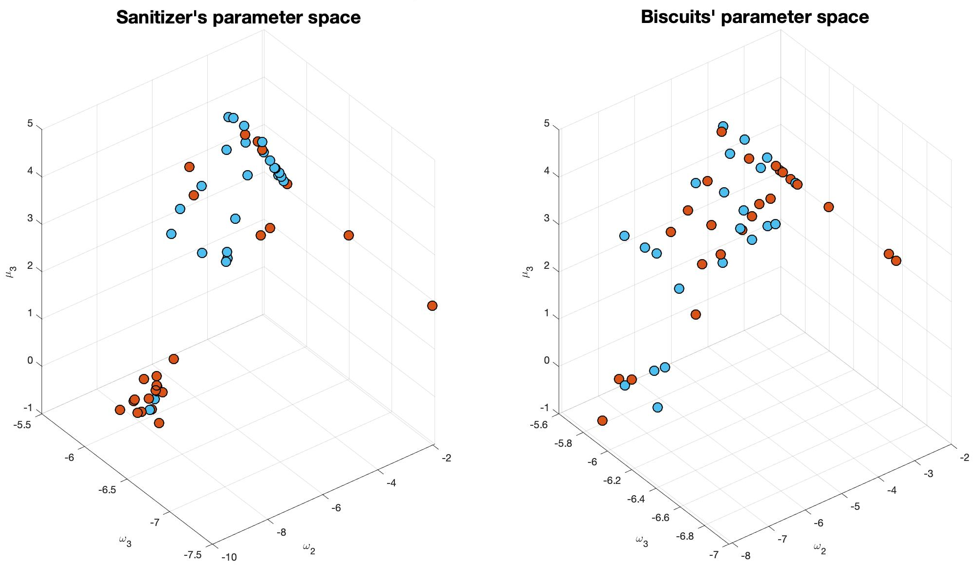
Parameters’ Estimation: Involving vs. Impartial
= Healthy Controls
= Anxious Patients
Notes:
The heart of our analysis consists of the estimation of three parameters of the perceptual model, namely the two default volatilities of the hidden states and the initial value of the random walk (mean value of the normal distribution of state_3).
These parameters are shown on the axes of the two graphs, which depict the distribution of the agents in the parameter space, for the two scenarios, involving on your left, impartial on your right.
The groups are identified via the two colors, blue for healthy controls, orange for Anxiety patients, which are going to be consistent over the whole presentation.
The subjects here are divided accordingly to the result of the anxiety quiz, which is our ground truth, and are balanced in the number.
As you can notice, the involving test presents two fairly visible regions, quite consistent with the ground truth, while the impartial test presents a more spread and chaotic point cloud.

Slide 7
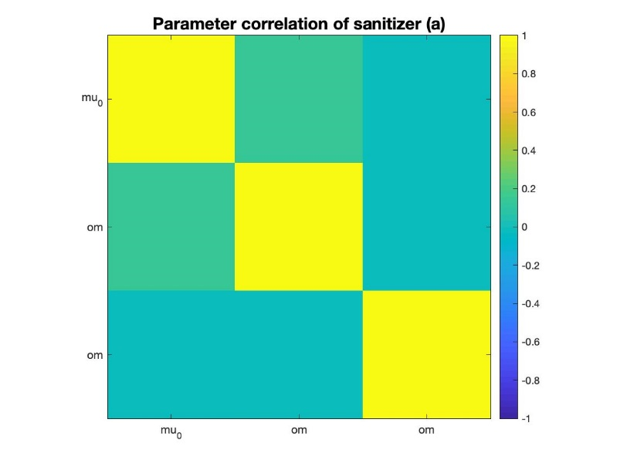
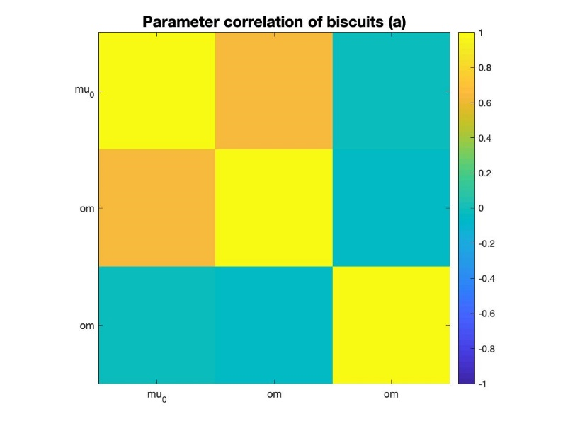
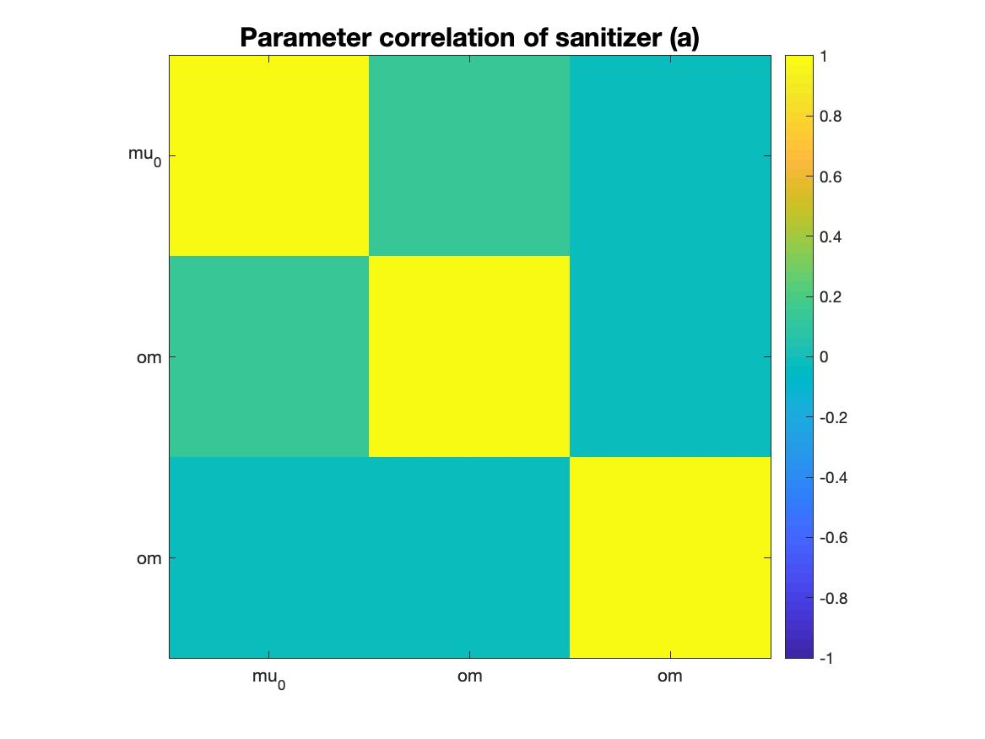
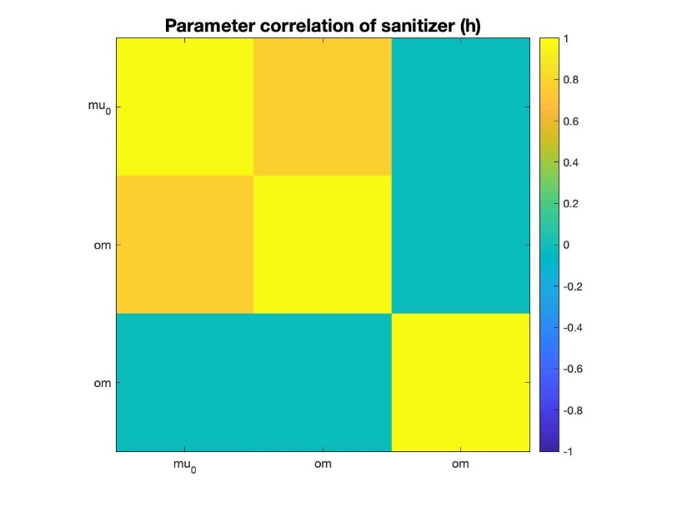
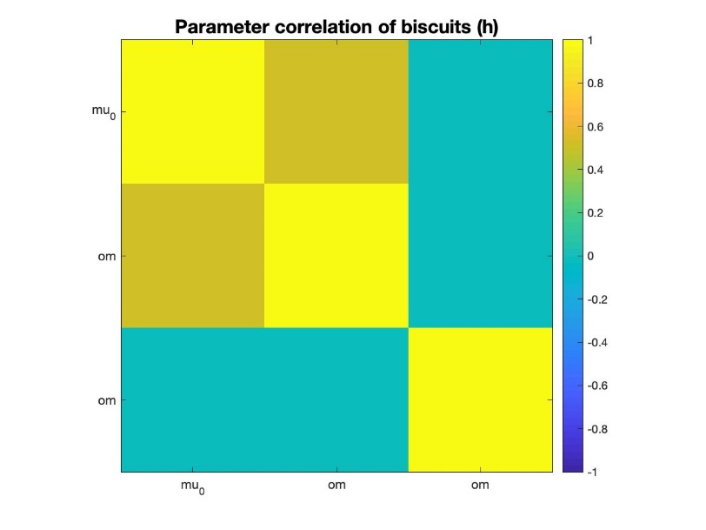
Parameters’ Correlation
Anxious
Healthy
Involving
Impartial
Notes:
Moreover, regarding the parameter, we analysed their correlation in the different configurations.
In all the cases, as you can see, they are never correlated which means they are independently identifiable. Consequently, changing a parameter is never fully equivalent to change another one.
(Including a readout of mu3 in the response model allows to get rid of the indeterminacy observed when using other models we tested during exercises.)

Slide 8
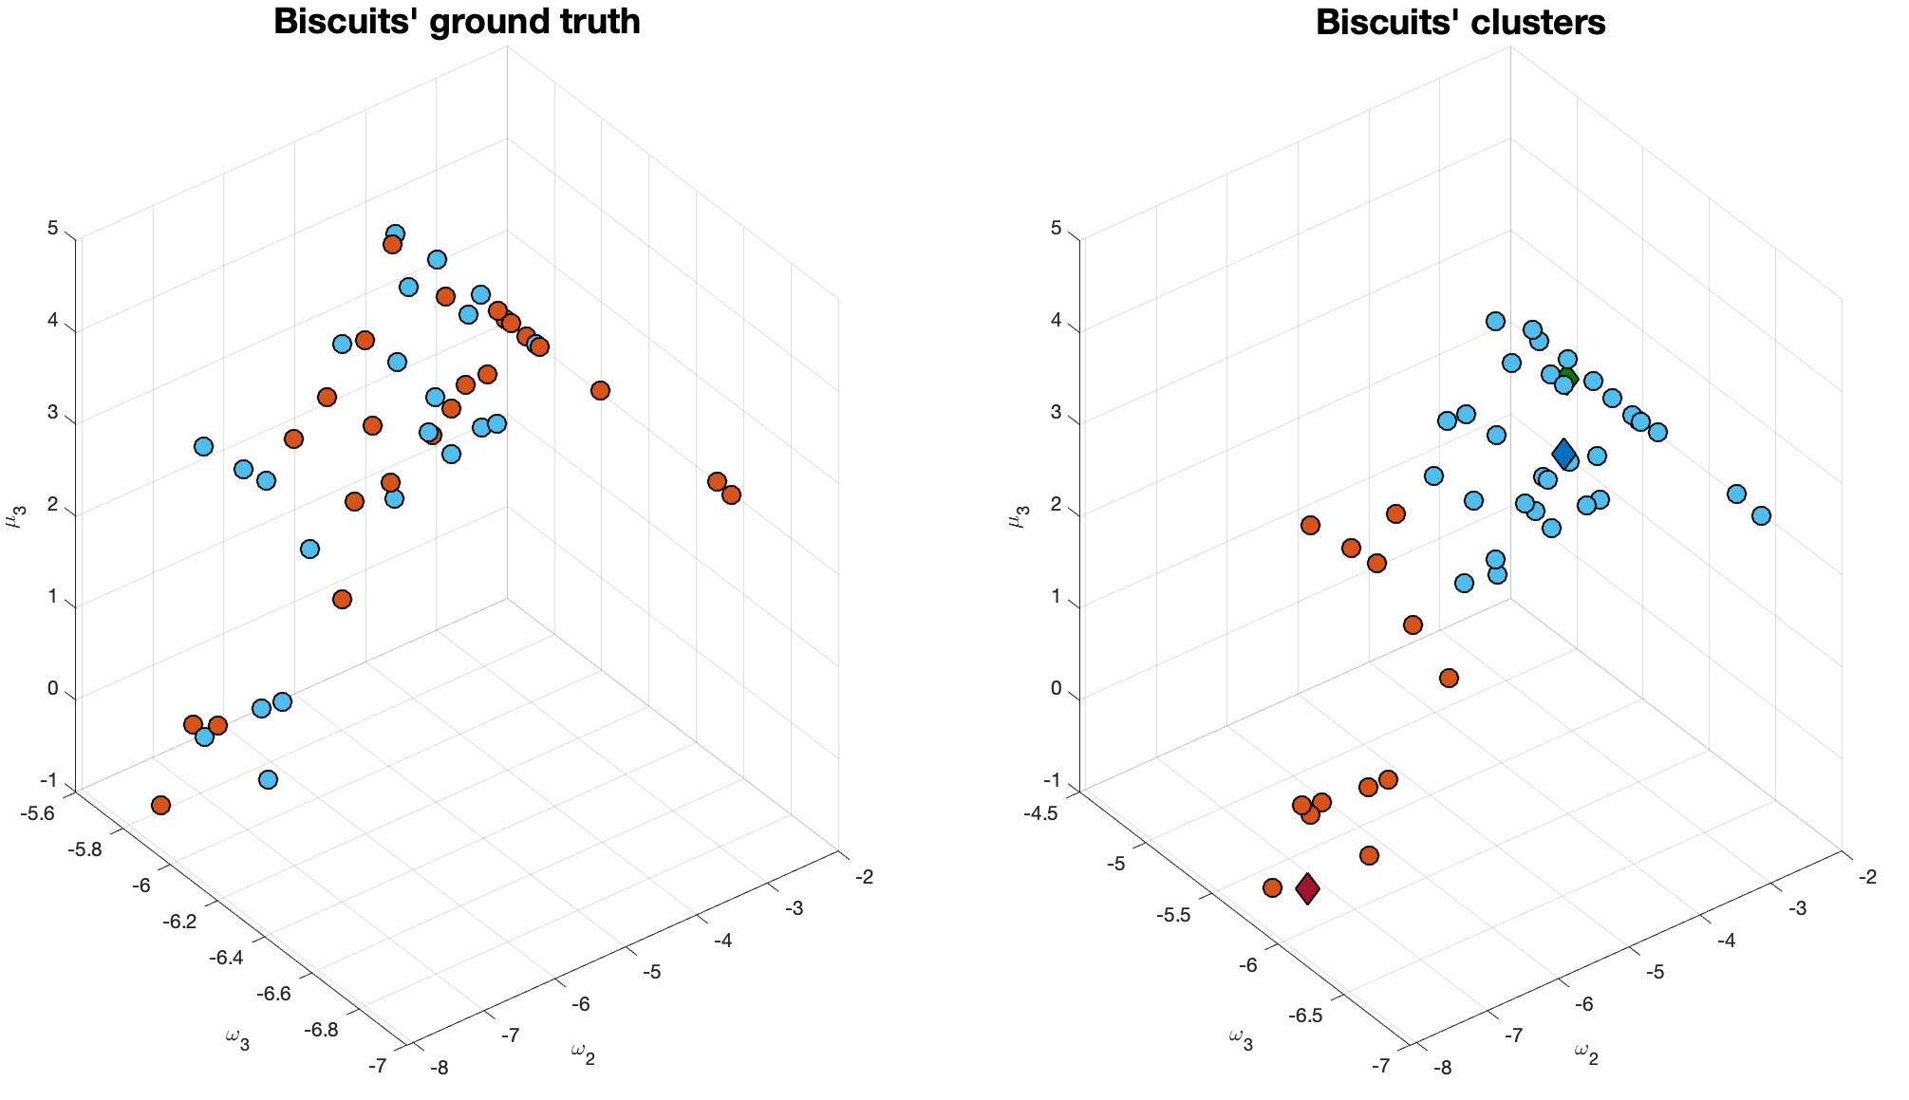
K-Means Clustering: Impartial Context
= Healthy Controls
= Anxious Patients
= Healthy Centroid
= Anxious Centroid
= Ideal Model
Notes:
Starting from the estimation of the parameters, we carry out K-means clustering to ideally distinguish healthy controls from anxiety patients and we compare the obtained results to our ground truth.
in this slide we present the results for the impartial test.
on the left you can see the classification of the subject according to the ground truth, while on the right there is output of the k-means clustering for the two groups.
We can see that in the impartial context the accuracy obtained is quite low, very close to 50%, which means that in this scenario all the users behave in a very similar way.
->Here there is a visual aid to identify the centroids of the clusters and the parameters of the ideal model in green.

Slide 9
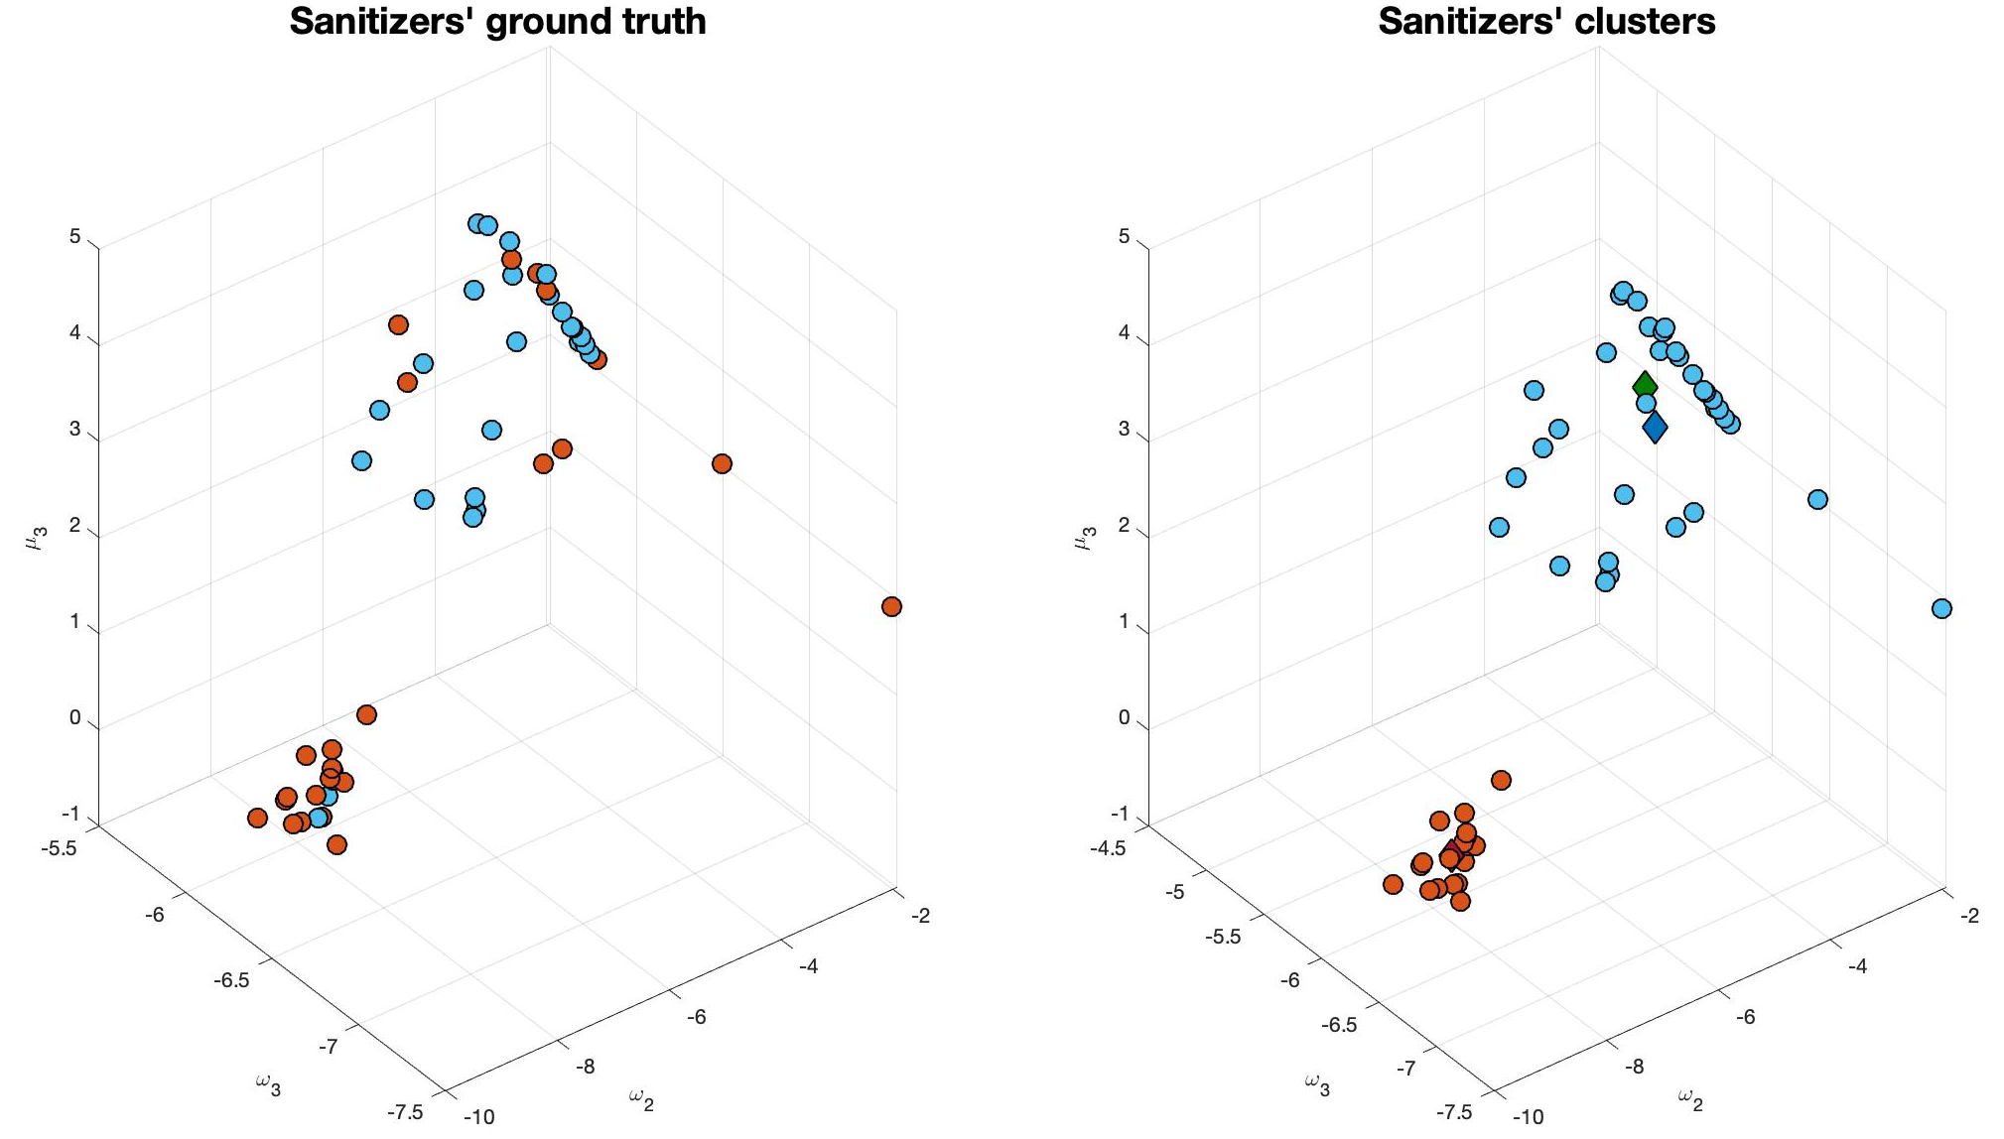
K-Means Clustering: Involving Context
= Healthy Controls
= Anxious Patients
= Healthy Centroid
= Anxious Centroid
= Ideal Model
Notes:
Here the same graphs are shown for the involving scenario.
As you can see, the behaviour of the k-means is way more consistent with the ground truth, leading to an accuracy of 76%.
This means that, as supposed, in a psychologically involving context the two groups behave differently enough to be distinguished in the majority of the cases.
->Moreover, as an additional insight, the estimation of the ideal parameters is closer to the healthy controls, which could possibly mean that the anxious people tend to drift from the ideal behaviour.

Slide 10
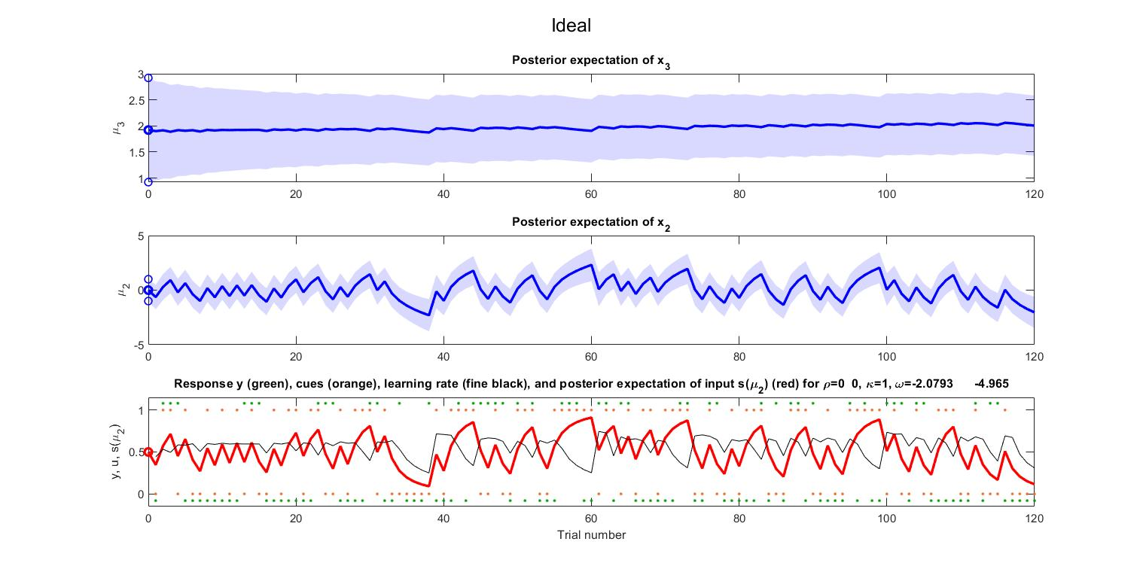
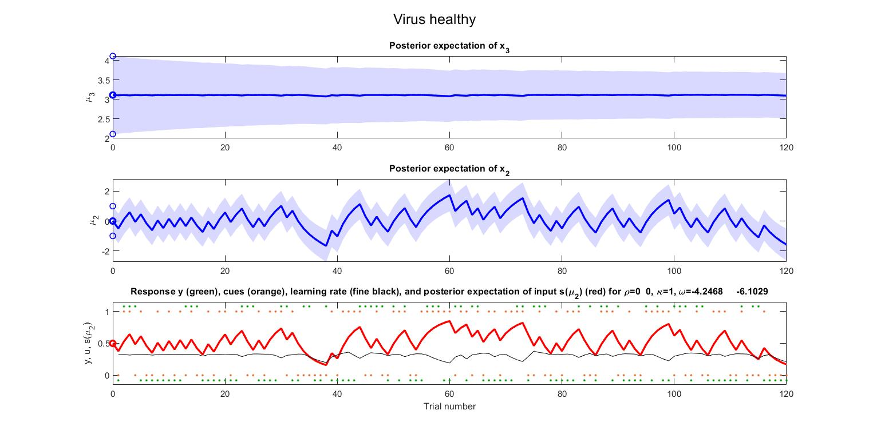
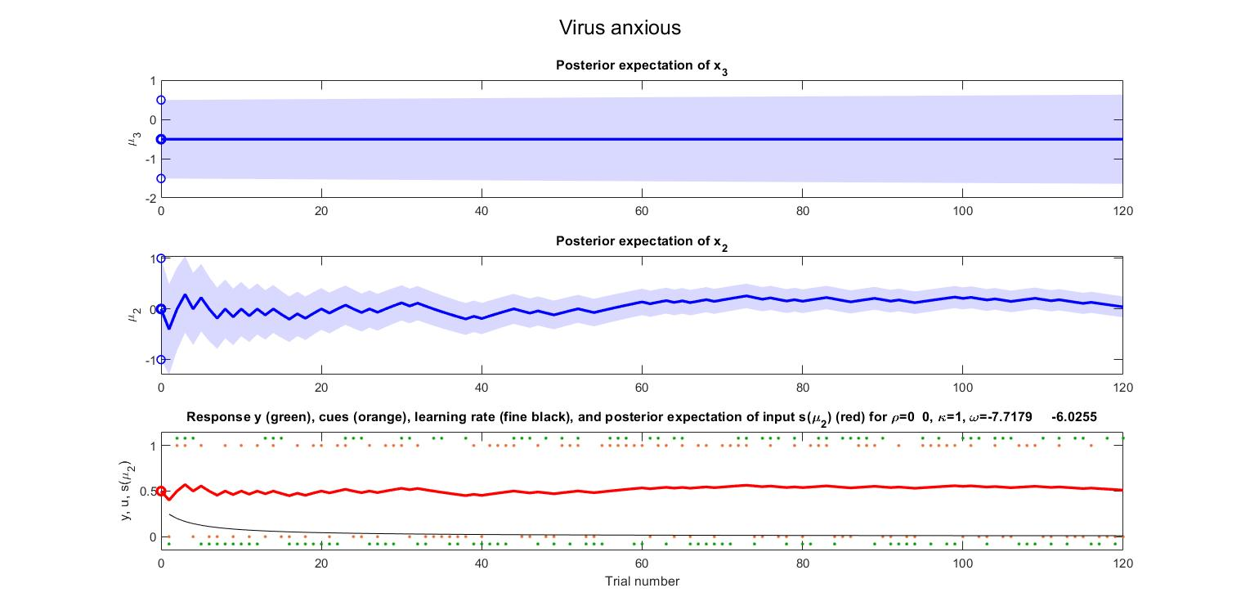
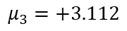
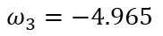
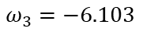
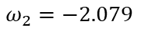
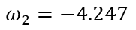
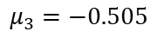
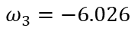
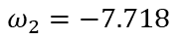
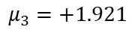
Comparison of Simulations: Ideal vs. Involving Test’s Centroids
Ideal
SCORE = 53%
$$ω_{2}=−2.079$$
$$ω_{3}=−4.965$$
$$μ_{3}=+1.921$$
Healthy
SCORE = 50%
$$ω_{2}=−4.247$$
$$ω_{3}=−6.103$$
$$μ_{3}=+3.112$$
Anxious
SCORE = 46%
$$ω_{2}=−7.718$$
$$ω_{3}=−6.026$$
$$μ_{3}=−0.505$$
Notes:
Finally, we compare the simulations with the ideal parameters, to the ones with healthy and anxious centroids, in the involving context.
The analysis shows that the simulation with the healthy centroid is more similar to the ideal model than the one with the anxious centroid, which confirms what we just observed in the previous slide.
-> In addition, the subjects’ responses compared to the correct outcomes lead to the shown scores.
Healthy controls have a higher score when compared to the anxious patients, which AGAIN means that their response is closer to the ideal model than the other group.

Slide 11
Final Results: Summary
All the subjects behave in similar ways in an impartial context
Healthy Controls behave differently than Anxious Patients in a psychologically involving context
Healthy Controls have a higher score, closer to the ideal model
Clustering and scores support our hypothesis on anxiety during lockdown in Italy
Notes:
Let me sum up the conclusions gathered from our project.

Slide 12
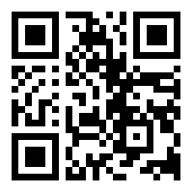
Thank you for your attention!
Branca, Francesco – fbranca@student.ethz.ch
Menini, Davide – dmenini@student.ethz.ch
Sangalli, Sara – sansara@student.ethz.ch
https://tnutest.altervista.org/

Slide 13
Back-Up Slides

Slide 14
Simulation of the Ideal Model
Notes:
Here we analyse the ideal response, from the top to the bottom you can see the hidden states in blue and the response in red.

Slide 15
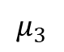
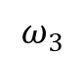
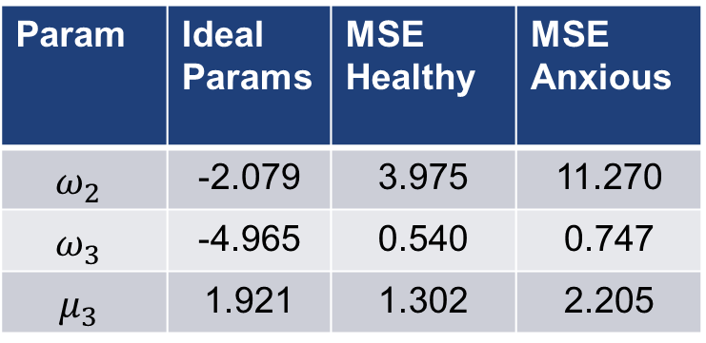
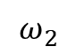
Comparison: MSE (Involving Test)
$$=MSE\left(est_ideal, est_h\left(i\right)\right) for i=1..N_h$$
$$=MSE\left(est_ideal,est_a\left(i\right)\right) for i=1..N_a$$
Healthy and anxious groups are based on ground truth
Param | Ideal Params | MSE Healthy | MSE Anxious
$$ω_{2}$$ | -2.079 | 3.975 | 11.270
$$ω_{3}$$ | -4.965 | 0.540 | 0.747
$$μ_{3}$$ | 1.921 | 1.302 | 2.205
$$ω_{2}$$
$$ω_{3}$$
$$μ_{3}$$

Slide 16
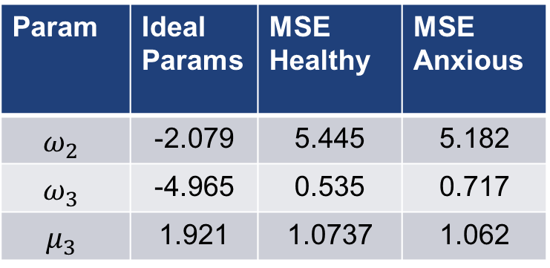
Comparison: MSE (Impartial Test)
$$=MSE\left(est_ideal, est_h\left(i\right)\right) for i=1..N_h$$
$$=MSE\left(est_ideal,est_a\left(i\right)\right) for i=1..N_a$$
Healthy and anxious groups are based on ground truth
Param | Ideal Params | MSE Healthy | MSE Anxious
$$ω_{2}$$ | -2.079 | 5.445 | 5.182
$$ω_{3}$$ | -4.965 | 0.535 | 0.717
$$μ_{3}$$ | 1.921 | 1.0737 | 1.062
$$ω_{2}$$
$$ω_{3}$$
$$μ_{3}$$

